Slide 1
Recommender Systems
Professor Robin Burke
Spring 2019

Slide 2
Welcome!
INFO 4871/5871: Special Topics in Information Science
Recommender Systems

Slide 3
Outline
Introductions
Example recommender system
Course overview and expectations

Slide 4
About me
Involved in recommender systems before the name was coined (1994)
knowledge-based recommendation
“critiquing systems”
Helped found a recommender systems start-up (1998)
which failed during the dot-com bust
Published the first systematic study of hybrid recommender systems (2001)
Research on attacks against recommender systems (2005-2009)
Research on recommendation in social tagging systems (2008-2011)
Research on recommendation in heterogeneous information networks (2012-present)
Latest interests: multistakeholder recommendation, fairness-aware recommendation
University of Chicago
UC Irvine
DePaul University

Slide 5
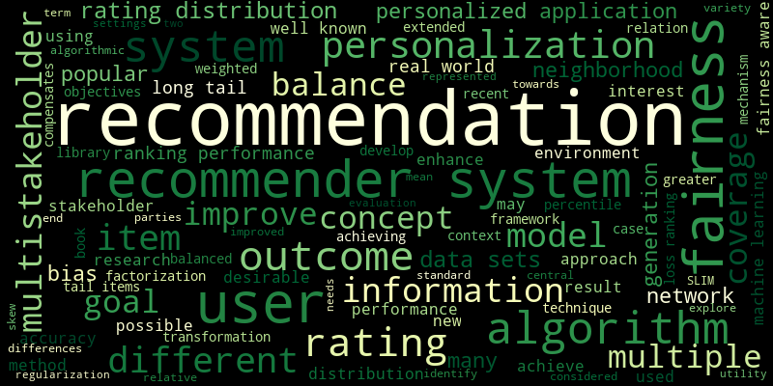
Recent research

Slide 6
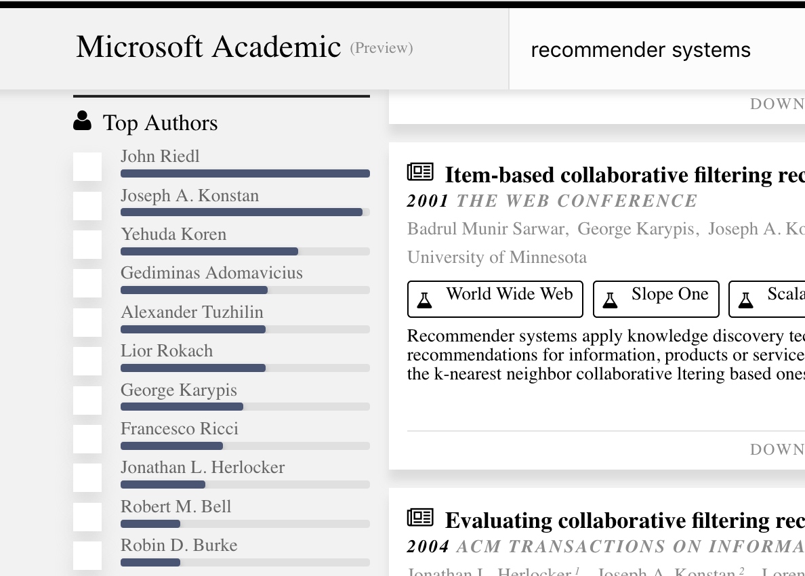
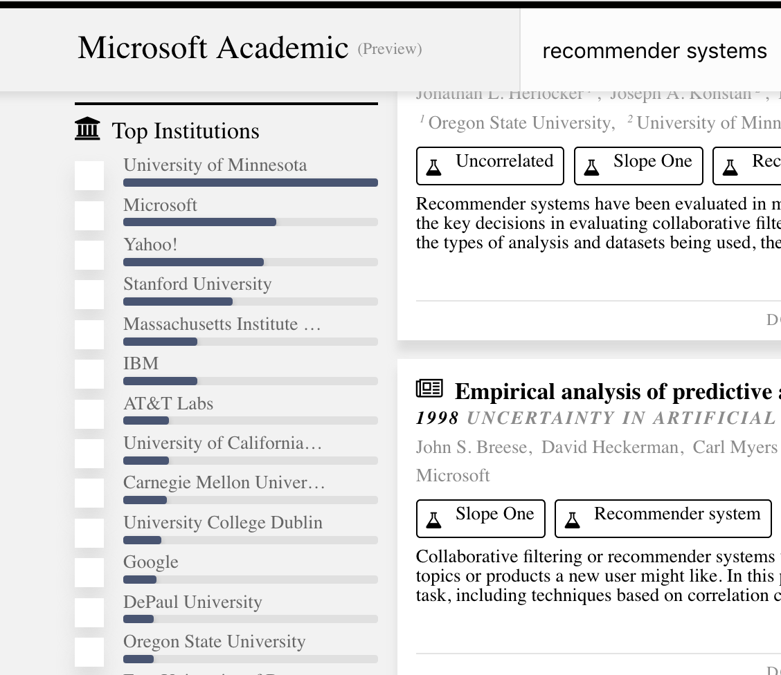
Some context
#11
#12 (#6 US University)

Slide 7
Introduction
Name
Degree program
Something true of you that’s probably not true of anyone else in the class
I’ll start!

Slide 8
Where I grew up
Holtville, California

Slide 9
Your turn
Fill out the form (10 minutes)
Then we’ll go around the class
Name (Let me know if it is different from what my roster says)
Degree program
Something true of you that’s probably not true of anyone else in the class

Slide 10
Contact info
Office:
TLC building (just north of CASE)
Rm 219, second floor
Office hours: Tu / Th 2:00 – 3:00 pm
Email: robin.burke@colorado.edu
Slack: Best for general class / homework questions
other students can benefit from the answer
don’t post code to slack
I may post your email to Slack if I think the answer has general interest

Slide 11
Form groups of three

Slide 12
Roles
The person in the group closest to me will be the User
The other two members of the group are the Recommender System
RS: Find a movie that you think the User will like

Slide 13
Process: use form
User: Write down two movies that you like
RS: Ask 10 questions but you can only ask about reactions to particular movies.
No questions about actors, movie genres, etc.
Only 8 movies (can ask fewer)
User will respond with 1 – 5 stars or “Don’t know”
You can explain the movie if it would help the User decide if they would like it
RS: Write down recommendation at the end
Don’t share with the User

Slide 14
Discussion
First: Movie
User: Is this a good recommendation? What would you need to know to be sure?
Recommender: What was your strategy in choosing movies?

Slide 15
Recommender systems
Personalized information access
A highly-interdisciplinary research area
HCI
AI / Machine Learning
Business / Economics
Advertising / Marketing
This is a “problem-focused” class
Cover different techniques needed to address this problem
Different from a “technique-focused” class
Learn a specific technique or family of techniques and how to apply
Consequence: we touch on a lot of different topics

Slide 16
Prerequisites
INFO 4871 – Junior standing in INFO program
Generally
Work with Python
Work with libraries: Pandas, matplotlib
Basic statistical knowledge: hypothesis testing, regression
Pluses
Jupyter notebook
Regularization
Linear algebra
Multi-variate calculus

Slide 17
Book
Aggarwal, Recommender Systems: The Textbook. Springer 2016.
This is not the book I would have written, but it is very comprehensive
Availability
Regular hardback via bookstore
Free PDF and ePub from Springer through CU Library
$25 softcover “MyCopy”
Demo
Reading the book is important
I will not have time to cover everything, esp. the math

Slide 18
Schedule (Part I)
More or less following the book
Some chapters we will go through more slowly
Week 1: Introduction
Week 2: Collaborative recommendation
Week 3 (1/31 only): Regression models
No class 1/29
Week 4: Matrix factorization / LKPy
Week 5: Learning factorizations / Content-based
Week 6: Domain Days
Group presentations

Slide 19
Schedule (Part II)
Week 7: Project brainstorming
Tuesday – Undergrads only
Thursday – Grads only
Week 8: Evaluation
Week 9: Knowledge-based and hybrid recommendation
Week 10: Context-aware recommendation
Week 11: Spring Break!

Slide 20
Schedule (Part III)
Week 12: Recommendations in networks
Week 13: Learning to rank
Week 14: Fairness-aware recommendation
Week 15: Presentations 1 & 2
Week 16: Presentations 3 / Posters
Finals week (5/5): No in-class meeting
Many things due

Slide 21
Grading
INFO 4871
Participation: 10%
Assignments: 30%
SCuiz: 20%
Group project: 40%
INFO 5871
Participation: 10%
Assignments: 30%
SCuiz: 20%
Domain presentation: 10%
Group project: 30%

Slide 22
Participation I
We will be using iClicker technology in this class
Interactive questions and exercises in each class
You get 1 point for each class where you participate
Participate on at least 75% of the exercises that day
Some days no exercises

Slide 23
Participation II
Three types of presentations
Domain presentations
Grad projects
Undergrad projects
Pick one presentation
Write a two-page reaction paper about it
I will hand out an outline to use
Due dates
2/26 (Domain presentation)
5/5 (Grad and Undergrad projects)

Slide 24
Assignments
5 programming / data analysis assignments
Additional requirements for INFO 5871
All will use Python
Jupyter notebook
Anaconda distribution recommended
Some will use the LKPy framework
Due dates:
2/5
2/26
3/12
4/2
4/16

Slide 25
Late policy
You have four “late days” with no penalty
Can be used on any assignment except social quizzes (more later) and on anything due the last day (5/5)
After four days are used up, assignments will not be accepted
I will not necessarily remind you of your late day status
it is up to you to keep track!

Slide 26
Quizzes
No midterm or final
Quiz questions through the “social quiz” platform scuiz
Demo

Slide 27
How it works
1 point for a correct answer
But you don’t get to answer questions unless you write questions
Can answer 10 questions for each question you add
Challenges
You can challenge a wrong or confusing question
Also worth 1 point
Easy questions are dropped
So the longer you wait
The harder the questions are
Might not be enough if you wait until the end

Slide 28
Multiple parts
Separate quizzes for grads and undergrads
SCuiz I
Starts Thursday 1/17
Ends 2/18
80 points
SCuiz II
Starts 2/19
Ends 4/1 (after Spring Break)
SCuiz III
Starts 4/2
Ends 5/5

Slide 29
Good question
For the compare instruction "cmpq a,b” in the x86-64 instruction set, the zero flag (ZF) is set when....
a == b
a > b
a < 0
(a-b) <0
Specific prompt
Clear answers

Slide 30
Bad question
What is a good proxy to use instead of CTR?
LPR (Landing Page Rate)
Conversion Rate
Click-Conversion Rate
Not enough context
Any answer could be correct, depending on context

Slide 31
Set up
There’s no enrollment email
I have created the quizzes and linked them to your email address
As I have it in the roster
You have to create an account with that address
Quiz will show up automatically

Slide 32
Project(s)
INFO 4871
Group project
INFO 5871
Domain presentation
Group project

Slide 33
“Domain days” presentations
I will assign interesting/unconventional recommendation domains
Not movies, books
Each group will deliver a presentation on
Unique challenges of doing recommendations for that domain
Companies and / or research projects
2/19 and 2/21
3-4 presentations per day

Slide 34
INFO 4871 final project
Group project
2-3 students
I will assign teams, but you can nominate on info sheet
Types
Implementation augmentation
Add to an existing system
Data + evaluation
Create a new data set from raw data
Evaluate different algorithms against it
Implementation
Create a web application delivering recommendations

Slide 35
INFO 4871 Milestones
2/5: Group formation
2/26: Project brainstorming (in-class)
3/5: Project proposal (7 points)
4/2: Progress report (28 points)
5/2: Poster (25 points)
5/2: Poster presentation (15 points)
5/5: Project report (125 points)

Slide 36
INFO 5871 final project
Group project
2-3 students
I will form teams but you can nominate
Types
Research proposal
A detailed literature review and proposal of new work
Research replication
Replication of a published research study
Research study
Small-scale and appropriate to student skills
Publication
High-quality projects may turn into publications at RecSys or UMAP

Slide 37
INFO 5871 Milestones
2/5: Group formation
2/26: Project brainstorming (in-class)
3/5: Project proposal (5 points)
4/2: Progress report (15 points)
4/23, 4/25, 4/30: Presentation (30 points)
5/5: Project report (100 points)

Slide 38
What to do now
Get the book in whatever form you prefer
Read Ch. 1 for Thursday
Get a clicker if you don’t have one
Bookstore or secondary market
Install latest Anaconda 3 distribution
Follow up Slack email invite
Sign up for SCuiz

Slide 39
See you Thursday!

